Slide 1
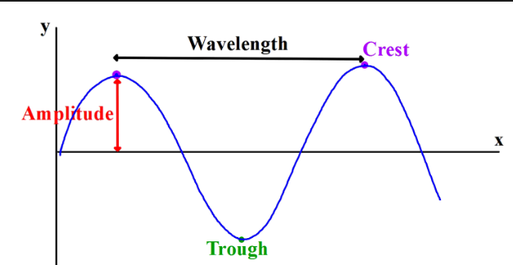
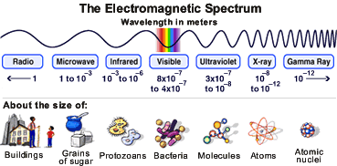
The Electromagnetic Spectrum
Learning Objectives:
To understand how wavelength and frequency are related across the spectrum..
To learn the uses and dangers of different EM waves.

Slide 2
Whiteboard Starter (3 mins):
Draw a wave.
Show its wavelength (λ)?
Show its amplitude?
  The height of a wave from the normal/baseline
What is its frequency (f)?
  The number of complete wavelength passing a point each second.
  Measured in Hertz (Hz).

Slide 3
Student Achievement Statements
Energy of Waves
I can deduce the position of a wave on the electromagnetic spectrum from given data
I can explain the uses and effects of different types of electromagnetic waves

Slide 4
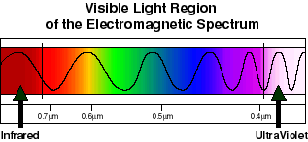
Frequency (f) increases as you go across the spectrum
Wavelength (λ) increases as you go down
ULTRA-
VIOLET
(UV)
MICRO-
WAVES
INFRA-
RED
(IR)
VISIBLE
X-RAYS
GAMMA
(γ)
RADIO
Red is always
Next to the
Infrared
Violet is always
Next to the
Ultraviolet

Slide 5
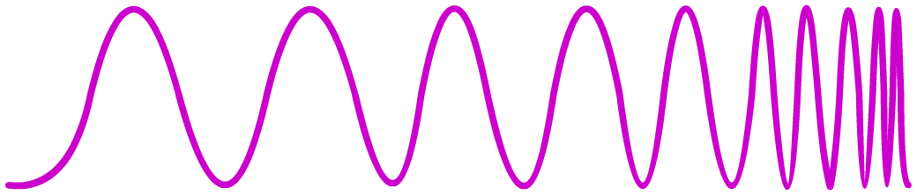
Are Electromagnetic Waves Dangerous?
The shorter the wavelength (and higher the frequency) of electromagnetic waves, the more energy that they carry.
radio waves
microwaves
infrared
visible light
UV
X-rays
gamma rays
10 m
10 cm
1 mm
0.01 mm
100 nm
1 nm
0.01 nm
energy increases
hazard increases
High-frequency electromagnetic waves, such as gamma rays, are potentially more harmful because they have more energy.

Slide 6
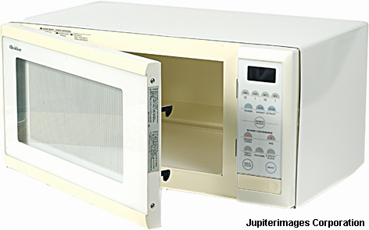
How do Electromagnetic Waves Differ?
Different electromagnetic waves carry different amounts of energy.
For example, microwaves carry less energy than X-rays.
The amount of energy carried by an electromagnetic wave depends on the wavelength: the shorter the wavelength, the higher its energy.
Wavelength and frequency are linked properties of a wave: the shorter the wavelength, the higher its frequency.
So, frequency also tells you about the energy of a wave:
the higher its frequency, the higher the energy.
Do microwaves have a shorter wavelength than X-rays?
Notes:
Photo credit: © 2006 Jupiterimages Corporation

Slide 7
1. Radio Waves

Slide 8
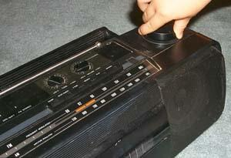
Radio Waves
Radio waves have the longest wavelengths in the electromagnetic spectrum.
These waves can be longer than a football field or as short as a football.
Radio waves do more than just bring music to your radio. They also carry signals for your television and mobile phones

Slide 9
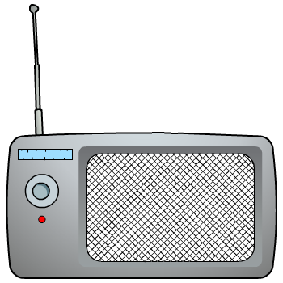

How do radio waves affect humans?
Radio waves
The longest-wavelength electromagnetic waves and mostly pass through the body.
They are not strongly absorbed and are thought to have no effect on the health of living tissue.
Mt Wellington (kunanyi) Radio Tower
130m tall!!
Delivers Free-to-air Television and Radio via Radio waves throughout Hobart.
Notes:
Photo credit: © 2006 Jupiterimages Corporation

Slide 10
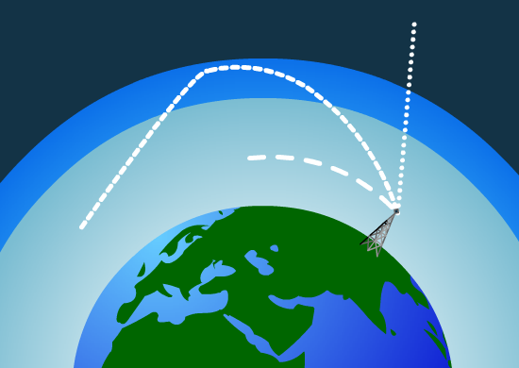
Sending signals into space
Some radio waves follow the contours of the Earth. These are called ground waves. These are typically waves with a frequency of 3–3,000 kHz because their long wavelength means they diffract around the curves of the Earth’s surface.
Radio waves that refract through the ionosphere and return to Earth, giving the impression of reflection, are called sky waves. Their frequencies are 3–30 MHz.
At frequencies over 30 MHz, radio waves can pass completely through the ionosphere and into space. These are called space waves.
Notes:
Teacher notes
See the ‘Reflection and Refraction’ presentation for more information on refraction.
‹#›

Slide 11
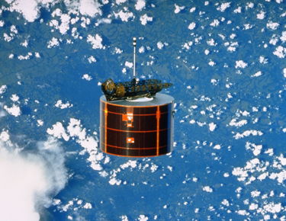
Communicating with satellites
Space waves are used to communicate with satellites. These waves are known as microwaves because of their short wavelength compared to other radio waves.
Microwaves only diffract by a small amount due to this short wavelength, so they can be sent to a satellite in a thin beam to save energy. The satellite can then send a second beam back to earth in response.
Radio waves with a frequency of greater than 30 GHz are easily absorbed and scattered by dust and water in the atmosphere, so they have little practical use.
Notes:
Teacher notes
See the ‘Orbits’ presentation for more information on the different types of satellite orbit.

Slide 12
2. Microwaves

Slide 13
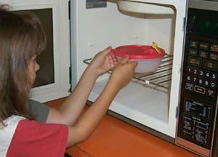
Microwaves
Microwaves length (cm)
The longer microwaves, are the waves which heat our food in a microwave oven.
Shorter microwaves are used in remote sensing.
  These microwaves are used for radar like the doppler radar used in weather forecasts.
Microwaves work by vibrating water molecules present in the food to heat up the food via radiation!

Slide 14
3. Infrared Light
(Term 1 Recap)

Slide 15
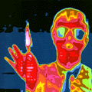

Infrared Waves
Infrared light lies between the visible and microwave portions of the electromagnetic spectrum.
Infrared light has a range of wavelengths, just like visible light has wavelengths that range from red light to violet.
Infrared is used for:
  Heating
  Thermal detection e.g. police
  Weather forecasting
  Remote control devices
  Communication

Slide 16
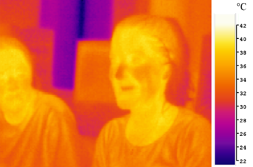
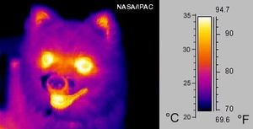
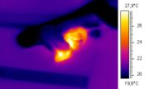
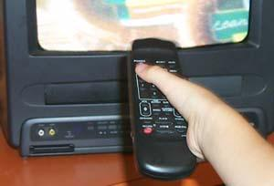
Snake eating a mouse

Slide 17
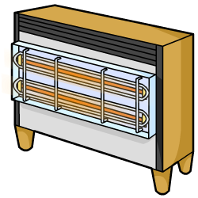

What are infrared waves?
We experience infrared waves everyday in the form of heat.
Infrared radiation is a form of electromagnetic radiation that lies between microwaves and visible light on the electromagnetic spectrum.
microwaves
visible light
infrared
10 mm
0.1 mm
0.001 mm
0.00001 mm
wavelength of electromagnetic waves
Infrared waves have wavelengths between 1 mm (about the size of a pin head) and about 0.0001 mm (about the size of
a cell).

Slide 18
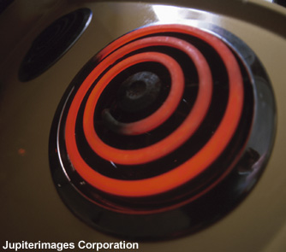
What produces infrared waves?
Infrared radiation is emitted by all objects but is not visible to humans.
The hotter an object is, the more infrared radiation it emits.
As an object gets hotter, visible light is also emitted. This is what can be seen when an object glows ‘red hot’.
Notes:
Photo credit (top right): © 2006 Jupiterimages corporation
Glowing coil on electric cooker.
Photo credit (bottom left): Ted Kinsam/Science Photo Library
A thermogram of a woman drinking a glass of cool water. The temperature range goes from hot (white) to cold (blue). Thermography is a technique for visualizing the temperature of surfaces by recording the emission of long-wavelength infrared radiation.

Slide 19
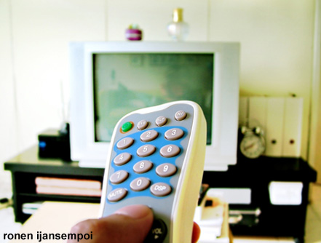
How is infrared used in remote controls?
Infrared radiation with short wavelengths are not hot and cannot be detected by skin.
This type of infrared radiation is used by remote controls to send information through the air over short distances.
The pulses of infrared radiation from the remote control can only travel in a straight line to the device being controlled.
Infrared waves can also be used to transmit information through optical fibres. In this way, infrared radiation can send data over long distances and around corners.
Notes:
Photo credit: ijansempoi ronen
Remote control being used to operate television on the other side of a room.

Slide 20
Nintendo Wii Demonstration IR Radiation

Slide 21
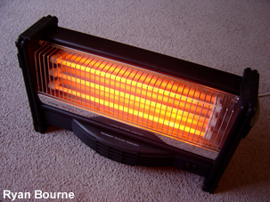
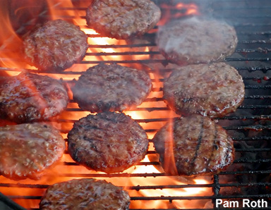
How is infrared used for heating and cooking?
The infrared radiation emitted by the Sun, radiators, solid fuel fires and electric fires is used for heating.
The heating effect of infrared radiation is detected by temperature sensitive nerve-endings in skin.
Grills, cookers, toasters, campfires and barbecues use infrared radiation to cook food.
Infrared waves are emitted by the heating element or lit fuel and absorbed by the surface of the food. Heat is transferred through the food by conduction.
Notes:
Photo credit (top right): Ryan Bourne
Glowing electric heater.
Photo credit (bottom left): Pam Roth
Burgers being cooked on a barbecue.

Slide 22
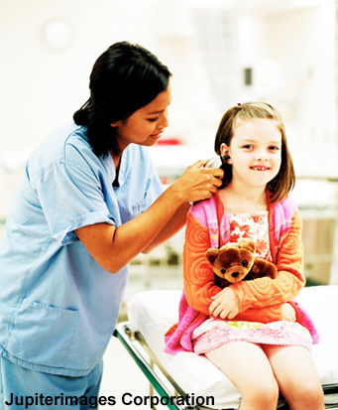
How do infrared thermometers work?
An infrared thermometer enables the remote sensing of temperature. It does this by detecting the infrared radiation emitted by an object and converting it into a temperature.
The eardrum is an accurate point for measuring the body’s temperature, because it is deep within the head.
A digital ear thermometer can do this without touching the eardrum, which is very fragile.
A probe is inserted into ear canal and then measures the infrared radiation emitted from the eardrum and surrounding tissues.
Notes:
Photo credit: © 2006 Jupiterimages corporation
Young patient having her body temperature measured by a nurse using a digital ear thermometer.

Slide 23
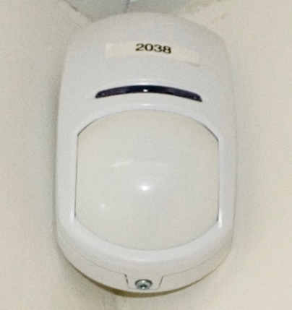
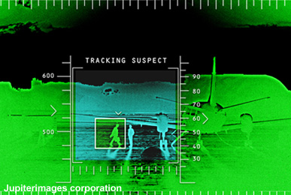
How can infrared waves fight crime?
Devices containing infrared detectors are used for various security purposes.
Sensors in security lights and burglar alarms can detect the infrared radiation given off by an approaching body.
Thermal imaging equipment, as used by the military and police, detects infrared radiation and converts it into an image. Objects such as people and cars, that are hotter than the background can be easily tracked even at night.
The emergency services use thermal imaging cameras to help locate people in situations where visibility is low.
Notes:
Photo credit (bottom left): © 2006 Jupiterimages Corporation
On-screen view from night vision equipment being used for surveillance at an airfield.

Slide 24
How do infrared waves affect humans?
Infrared waves are absorbed by skin to a limited depth. They transfer their energy to the skin tissue warming it up.
This heating effect is detected by temperature-sensitive nerve endings in the skin.
Infrared waves from this grill heat the surface of the meat.
If the meat absorbs too much energy, it will become burnt.
If skin is exposed to too many high-energy infrared waves, it will become burnt.
Notes:
Photo credit: Pam Roth (compliments of CreatingOnline.com)

Slide 25
4. Visible Light

Slide 26
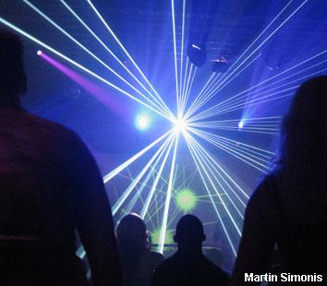
How does visible light affect humans?
Your eyes detect visible light, which does not normally pose any health risk.
However, very bright light can damage your eyes and may even make you blind.
Lasers are very intense sources of visible light. The lasers used in light shows are not powerful enough to cause harm but must be used safely.
Some very powerful lasers can cut through materials such as metal. These would also be able to burn through living tissue.
Notes:
Photo credit: Martin Simonis
Where do we normally go to shoot lasers at each other?

Slide 27
5. Ultraviolet Light

Slide 28
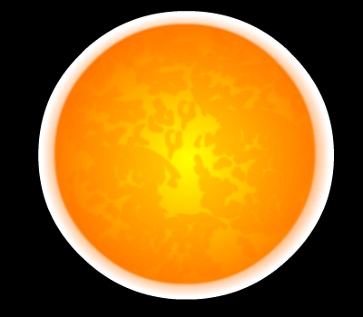
What is the main source of UV Radiation on Earth?

Slide 29
What is ultraviolet (UV) radiation?
Everyday we are exposed to ultraviolet (UV) radiation emitted by the Sun.
UV radiation is high-energy electromagnetic radiation that is found between visible light and X-rays on the electromagnetic spectrum.
ultra-violet
gamma
rays
infrared
X-rays
10⁻³
10⁻⁶
10⁻⁹
10⁻¹²
wavelength of electromagnetic waves
The wavelength of UV radiation ranges from 10 to 1000 nm.
Humans cannot see UV radiation but research has shown
that bees, birds, butterflies and other insects can.

Slide 30
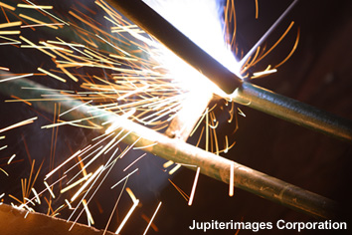
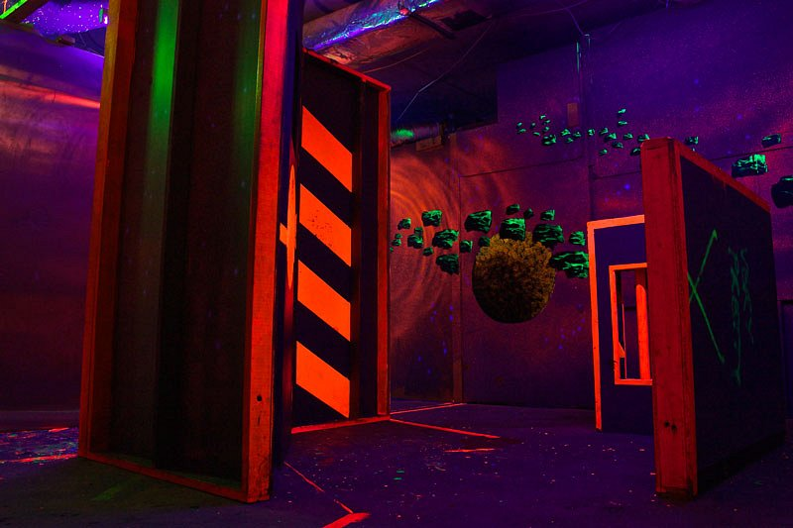
How is UV light produced?
Ultraviolet radiation is emitted by very hot objects, such as the Sun.
Electrical sparks and arc welding also reach temperatures that are high enough to produce ultraviolet radiation.
Some gases emit ultraviolet radiation when an electric current is passed through them.
Tanning beds and the ‘black lights’ seen in Zone-3 use ultraviolet rays
Notes:
Photo credit (top right): © 2006 Jupiterimages corporation
Sparks from arc welding.
Photo credit (bottom left): Curro Jimenez
A sunbed made up of fluorescent tubes, which emit ultraviolet radiation.

Slide 31
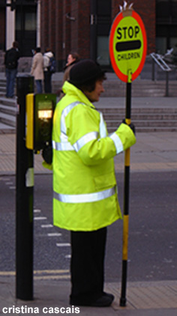
What is ultraviolet radiation used for?
Bright clothing
Certain chemicals can absorb UV radiation and then re-emit it as visible light. Some washing powders use these to make white material appear whiter in sunlight. Such chemicals are also used in safety clothing.
Security marking
Special inks, that are only visible under UV radiation, are used to security mark expensive items.
Tanning
UV radiation in sunlight causes skin to tan. Tanning beds imitate sunlight by emitting artificially-produced UV rays.
Notes:
Photo credit: Cristina Cascais
A lollipop lady wearing a fluorescent high-visibility jacket, whilst patrolling a school crossing.

Slide 32
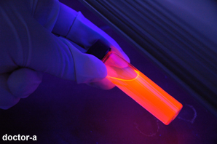
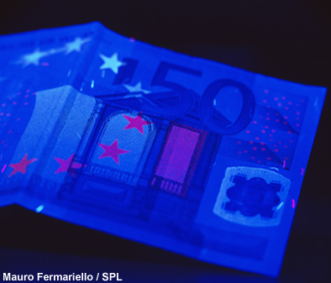
How can UV light help prevent fraud?
Chemicals that absorb energetic ultraviolet radiation and re-emit it as less energetic visible light are said to be fluorescent. These chemicals are used in inks and in safety clothing.
Fluorescent inks, that are not visible under normal light, are used in banknote production to prevent fraud. The inks identify genuine banknotes by glowing brightly under ultraviolet light.
Fluorescent inks are also used in stamps to distinguish different values for automatic sorting.
Notes:
Photo credit (top right): doctor-a
A sample of a highly fluorescent liquid.
Photo credit (bottom left): Mauro Fermariello /Science Photo Library
Euro banknote in ultraviolet light. This highlights security features intended to prevent fraud. Fluorescent ink and strips glow bright blue and red under ultraviolet light, and show that this is a genuine banknote.

Slide 33
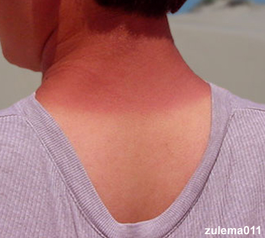
How does UV radiation affect skin?
The skin uses UV radiation from the Sun to make vitamin D, which is needed for strong bones. Some exposure to UV radiation is beneficial but overexposure is generally harmful to the skin and eyes.
Ultraviolet radiation can kill cells. Sunburn occurs when the skin is exposed to high-intensity ultraviolet radiation, which damages and kills skin cells.
Over time, repeated exposure leads to premature ageing of the skin and increases the risk of skin cancer.
Intense UV radiation can inflame the eyes and long-term
exposure may cause cataracts.
Notes:
Photo credit: zulema011
The sunburnt skin on the neck, which has been overexposed to ultraviolet radiation in sunlight, appears in sharp contrast to the normal skin on the back, which has been covered by a T-shirt.

Slide 34
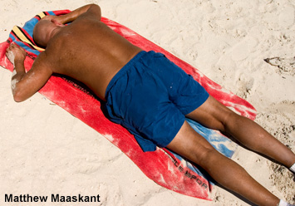
Is a suntan safe?
Some people believe a suntan is safe and makes them look healthy.
Discuss with the person next to you:
Your worst sunburn!
What do you think makes people tan?
Why some people burn more easily than others?
3 ways you can prevent sunburns
Notes:
Photo credit: Matthew Maaskant
A man, with heavily tanned skin, sunbathing on a beach. The paler, natural colour of the man’s skin is visible on his legs at the bottom of his shorts.

Slide 35


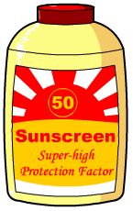
How can exposure to UV radiation be limited?
Prolonged exposure to UV radiation carries serious health risks and so protection is important.
A combination of measures can protect skin and eyes from UV radiation:
Cover up, stay in the shade, wear a
wide-brimmed hat and sunglasses.
Sunblock and sunscreen protect the skin by blocking UV radiation. When out in the Sun for prolonged periods, these should be applied to the skin generously and often.
Protection is essential for workers who are routinely exposed to UV radiation. Welders must use a head shield to protect
their eyes and wear thick clothing to protect their skin.

Slide 36
Ultraviolet – opinion or fact? (whiteboard 3 mins)
Notes:
Teacher notes
This true-or-false activity could be used as a plenary or revision exercise on ultraviolet waves, or at the start of the lesson to gauge students’ existing knowledge of the subject matter. Coloured traffic light cards (red = false, yellow = don’t know, green = true) could be used to make this a whole-class exercise.

Slide 37
6. X-rays

Slide 38
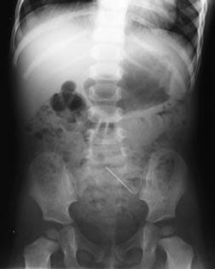
X-Rays
What would it be like to see X-rays?
Well, we wouldn't be able to see through people's clothes, no matter what the ads for X-ray glasses tell us!
If we could see X-rays, we could see things that either emit X-rays or halt their transmission.
X-ray film "sees" X-rays, like the ones that travel through your skin. It also sees shadows left by things that the X-rays can't travel through (like bones or metal).

Slide 39
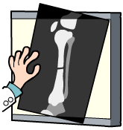
What are X-rays?
Anyone who has been to hospital with a broken bone will have had an X-ray photograph taken.
X-rays are a form of electromagnetic radiation that are very penetrating. In the electromagnetic spectrum, they are found between UV and gamma rays.
ultra-violet
gamma
rays
infrared
X-rays
10⁻³
10⁻⁶
10⁻⁹
10⁻¹²
wavelength of electromagnetic waves
X-rays have a very short wavelengths between 0.1 and 10 nm.
(The size of a water molecule is about 0.3 nm.)

Slide 40
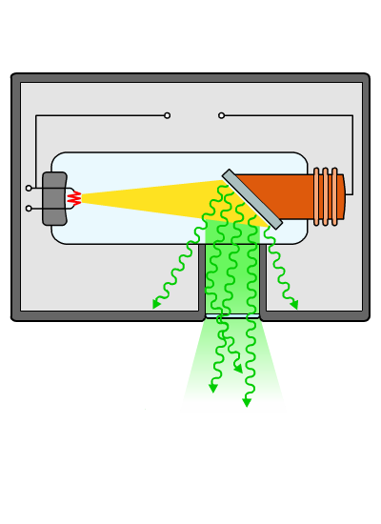
How are X-rays produced?
X-rays are created when high-energy electrons suddenly lose energy. X-rays are produced artificially using a X-ray tube.
high
voltage
anode
cathode
tungsten
target
lead
shielding
X-rays
Electrons from the hot cathode are fired at the tungsten target at high speed. When these high-energy electrons strike the target, some of their energy is changed into X-rays.

Slide 41
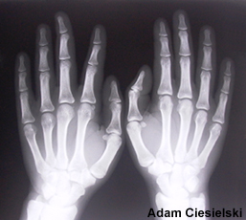
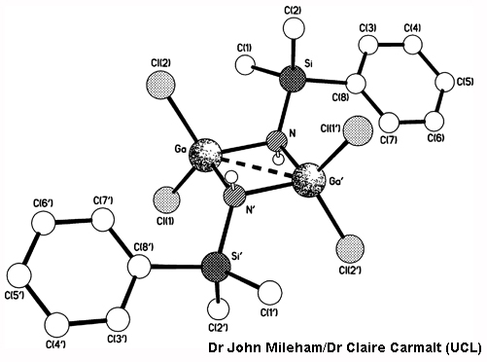
What are X-rays used for?
Imaging
X-rays are very penetrating and can pass through many forms of matter. They are used in medicine, industry and security to take pictures of the inside of objects.
Treating cancer
Concentrated beams of short wavelength X-rays can be used to kill cancerous cells.
Crystallography
X-rays are used to work out the arrangement of atoms in various substances, including crystals.
Notes:
Photo credit (top right): Adam Ciesielski
X-ray of hands.
Photo credit (bottom left): Dr John Mileham/Dr Claire Carmalt (UCL)
Crystal structure of [Cl₂GaNH(SiMe₂Ph)]₂.

Slide 42
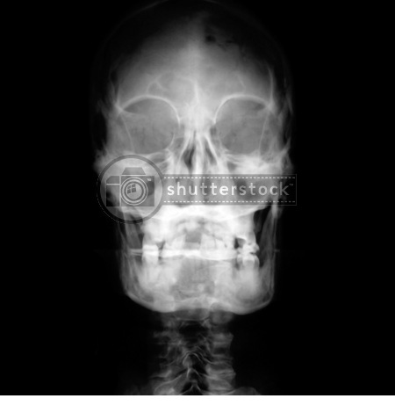
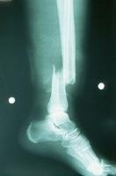
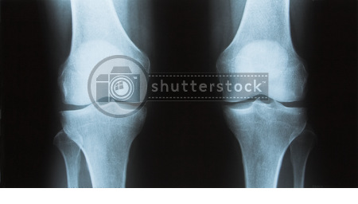
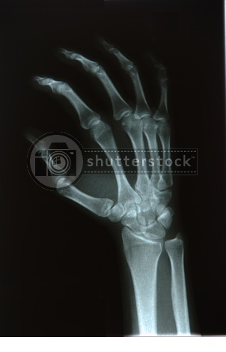
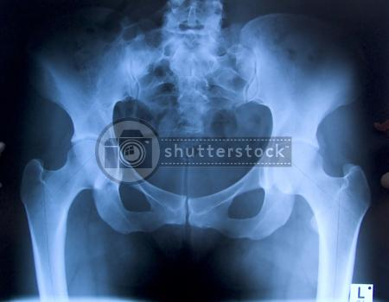
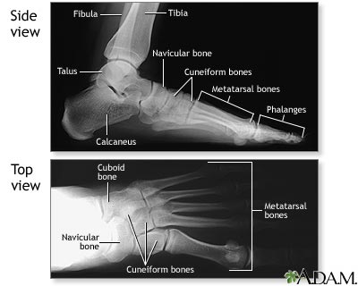
What do you look
like in x –rays?

Slide 43
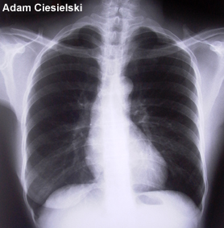
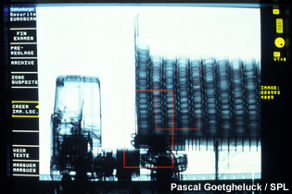
How can X-rays ‘look inside’ objects?
X-rays images can be taken because X-rays can pass through opaque materials and also expose photographic film.
X-rays pass through soft tissue, such as skin and muscle, without being absorbed. Denser tissue, such as bone, can absorb X-rays. Film that is exposed appears black and areas that are not exposed, because of X-ray absorption, appear white.
X-rays are used by customs staff to check for weapons and drugs. Baggage is passed through an X-ray machine, which instantly reveals the contents. Even an articulated lorry can be X-rayed!
Notes:
Photo credit (top right): Adam Ciesielski
X-ray of the chest cavity in which the heart and ribs are visible.
Photo credit (bottom left): Pascal Goetgheluck/Science Photo Library
Monitor view of a scanning X- ray of a lorry made during a customs check. This X-ray was produced by a Sycoscan X-ray machine which scans large objects like vehicles, gradually producing a composite image of them. Any suspect areas can be magnified on the screen and then, if necessary, checked by hand. Photographed at Roissy/Charles de Gaulle Airport in Paris, France.

Slide 44
What do X-rays do to cells?
Notes:
Teacher notes
This three-part animated sequence illustrates the effects of X-rays on living tissues. While viewing the animation, it should be highlighted that exposure to high levels of X-rays can be harmful.

Slide 45
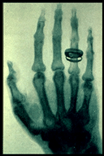
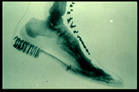
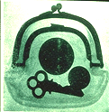
The earliest X-ray images
Early researchers did
not know the dangers
of x-ray radiation.
they did countless
experiments looking at
body movement.
even getting babies to
walk in front of the screen
Duh!
Consequently, many of
the pioneers of this
technology died
prematurely of leukamia
and cancers ☹

Slide 46
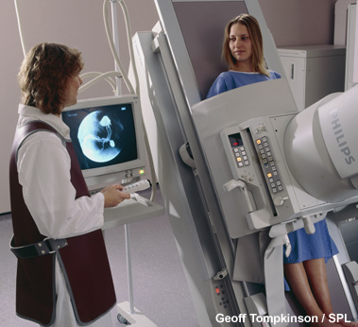
How are X-ray images taken safely?
Precautions must be used when X-ray images are taken.
Only the area of the body being examined is targeted with X-rays. Other areas are protected with lead shield, which is too dense
for X-rays to pass through.
One-off X-rays do not pose much risk to health. Radiographers take several X-rays each day and their potential dose is much higher.
To minimise their exposure when an X-ray image is being taken, radiographers must wear a lead apron (shown), stand behind a screen that absorbs X-rays or even leave the room.
Notes:
Photo credit: Geoff Tompkinson/Science Photo Library
Radiographer conducts a barium meal stomach X-ray on a woman patient in a fluoroscopy suite. The patient is on a reclining bed after having swallowed a liquid barium meal. The X-ray apparatus is then placed over the patient's abdomen (as seen here). A barium meal is opaque to X-rays and it shows up the structure of the digestive tract. The screen at left reveals a barium X-ray of the curved sac of the stomach. Barium X-rays are used to diagnose the cause of swallowing difficulty, check for inflammation of the oesophagus or stomach, detect stomach ulcers and bleeding, and reveal disorders in other parts of the bowel.

Slide 47
X-rays – true or false?
Notes:
Teacher notes
This true-or-false activity could be used as a plenary or revision exercise on X-rays, or at the start of the lesson to gauge students’ existing knowledge of the subject matter. Coloured traffic light cards (red = false, yellow = don’t know, green = true) could be used to make this a whole-class exercise.

Slide 48
7. Gamma Radiation

Slide 49

What are gamma rays?
Gamma rays are emitted by certain radioactive materials and have many uses in medicine.
Gamma rays are the highest-energy form of electromagnetic radiation and are beside X-rays in the electromagnetic spectrum.
ultra-violet
gamma
rays
infrared
X-rays
10⁻³
10⁻⁶
10⁻⁹
10⁻¹²
wavelength of electromagnetic waves
Gamma rays have wavelengths between 0.001 and 0.1 nm (less than the size of an atom), which makes them the form of electromagnetic radiation with the shortest wavelengths.

Slide 50

What are gamma rays used for?
Medical imaging
A gamma scan is obtained by injecting a radioactive tracer, which concentrates in the area of the body being investigated. Gamma rays emitted from this area are detected by a gamma camera.
Sterilizing
Gamma rays are used to sterilize
medical equipment because they are highly penetrating and kill all living cells.
Industrial imaging
Gamma rays are even more penetrating than X-rays and can pass through denser materials. They can be used to examine metal castings and welded structures.
Notes:
Photo credit: ISM/Science Photo Library
Secondary bone cancer. Coloured gamma scans of the skeleton of a 71-year-old man with secondary bone cancer (red areas). The primary cancer is of the prostate gland. The skeleton is seen from the front (left) and from behind (right). The cancer has spread to the spine, skull, pelvis, ribs, and leg and arm bones. Cancer that spreads from its original site is referred to as secondary cancer, and the cancer is said to have metastasised. The prognosis is poor. A gamma scan (also called a scintigram) is obtained by injecting a radioactive isotope (here Tc-99m, or Technetium-99m). This tracer material becomes concentrated in the cancerous tissues and is detected by the gamma radiation it emits.

Slide 51

How can gamma rays be used to treat cancer?
Radiotherapy is the use of high-energy ionizing radiation, such as gamma rays, to kill cancer cells.
The radiation dose may come from a radioactive source in a machine outside the body, which directs a beam of radiation at the cancer cells.
Healthy cells can also be affected by the radiation applied to the body.
Steps to reduce the effects on healthy tissue include:
splitting the radiation dose into a number of treatments;
rotating the beam of radiation so that healthy cells receive a lower dose than the cancer cells.
Notes:
Photo credit: Martin Dohrn/Science Photo Library
Gamma radiotherapy using a "cobalt bomb", radioactive cobalt-60 being the most common source of gamma radiation. The cobalt source is housed in the large treatment head, and gamma radiation is released through a shutter when the machine is in operation.

Slide 52

How do ionizing waves affect humans?
Ionizing waves have enough energy to ionize the atoms in materials. These waves can have a severe effect on living tissue by killing cells or damaging DNA.
Ultraviolet rays are absorbed by the body. Skin tissues can be ionized and damaged by the shortest-wavelength ultraviolet radiation causing skin cancer.
X-rays pass through soft body tissue, such as skin and muscle, without being absorbed. Denser tissue, such as bone, absorb some X-rays and can be ionized.
Gamma rays pass through the body but very high energy waves can ionize atoms in living tissue.
NOTE: We will look more closely at this LATER in the
Term!!

Slide 53
Whiteboard Activity: Arrange the EM Waves
Notes:
Teacher notes
This ordering activity could be used as a plenary or revision exercise on the energy of electromagnetic waves. Mini-whiteboards could be used to make this a whole-class exercise.

Slide 54
Whiteboard Activity: Match the EM Waves
Notes:
Teacher notes
This matching activity could be used as a plenary or revision exercise on electromagnetic waves and how they affect living tissues. Students could be asked to complete the questions in their books and the activity could be concluded by the completion on the IWB.

